Slide 1

Coders Wanted 2022 Hackathon
Category 4: Open

Slide 2

Content
Introduction & Objective
Data Cleaning
Assumptions made on the data
1st level analysis
2nd level analysis
Take away from the Data

Slide 3

Introduction & Objective
This is a challenge by Coders Wanted 2022 Hackathon
I will be doing Category 4: Open.
The dataset provided seems to be information of users particularly on their occupation level as majority of the columns describe job related info.
Objective: I will try to uncover valuable insights from the dataset which may provide potential impactful changes to the data owner.

Slide 4
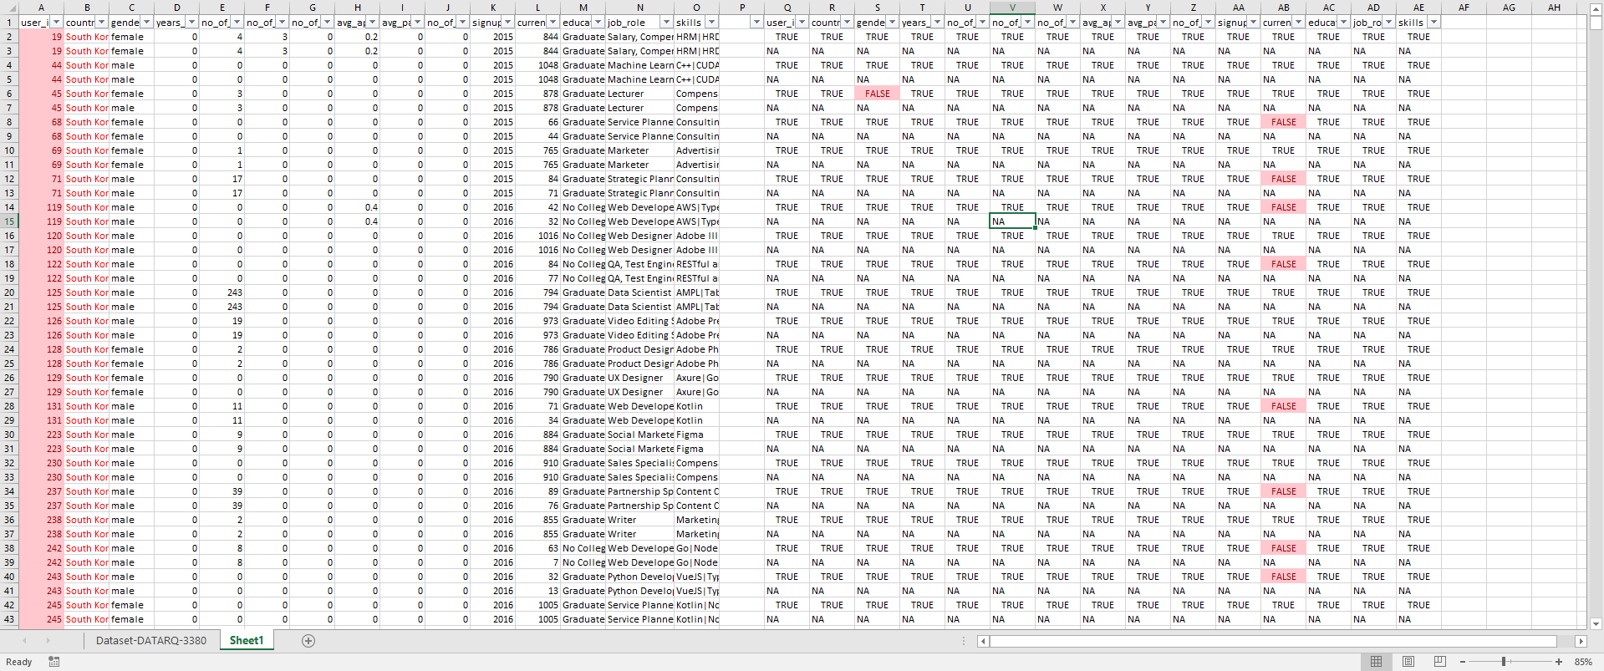
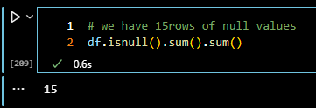
Data Cleaning
Using excel conditional formatting, and some matching, able to identify 1782 duplicates based on user_id column. In additional there are also difference between some of the duplicates for columns:
Country (e.g. user_id: 2206, all columns are similar except for country – one showing Japan, the other showing South Korea)
gender
avg_apply_pass
current_inactive_days
There are also 15 rows with null values in the dataset

Slide 5
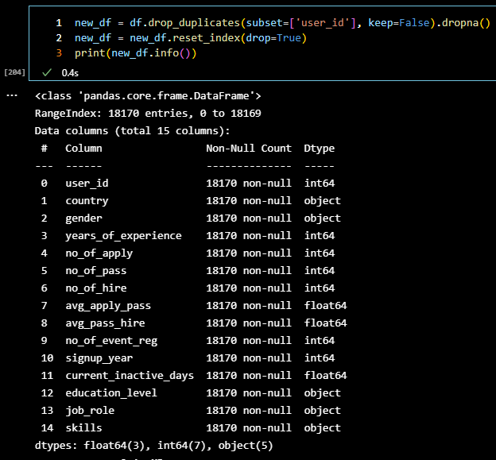
Data Cleaning
Given there are difference with some of the duplicate rows, I do not know which rows contain the accurate information. So I will be dropping all the duplicates and the null rows to be more accurate in the analysis.
As there is no metadata provided on the data set, assumptions will be made before making the analysis.

Slide 6
Assumptions
years_of_experience: the number of years of experience the users have
no_of_apply: the number of job applications the users have made
no_of_hire: times of being hired from their job applications
signup_year: number of new users sign up for that year
current_inactive_days: number of days users has been inactive for
job_role: job that the user is currently holding
skills: skills that the user currently have

Slide 7
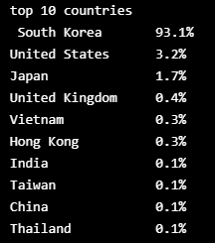
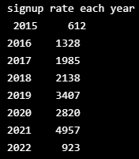
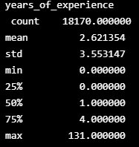
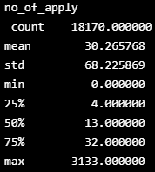
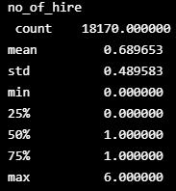
1st level analysis
A simple surface analysis tell us likely the data-owner is a recruitment firm, with strong presence in South Korea.
The company has been seeing a stable increase in sign up rates on their platform since 2015. (year 2022 not ended so not to take into account).
Average years of work experience of the users using the platform is at 2.6 years. Each users averagely applied 30 jobs, however the average hired rate is less than 1.

Slide 8
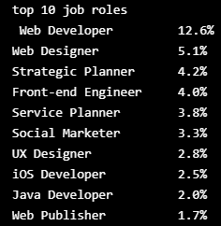
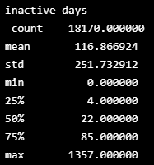

1st level analysis
The top few user’s job roles are mainly in the IT industry – shows that this recruitment company mainly focuses on IT sector job placements.
Lastly the average user’s inactive period is around 116 days (~ 4months).
56% of the users is only inactive for less than a month, followed by 29% for between a month to half a year, 7.8% more than half a year to a year and lastly 7.1% has been inactive for more than a year.

Slide 9
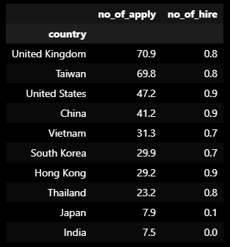
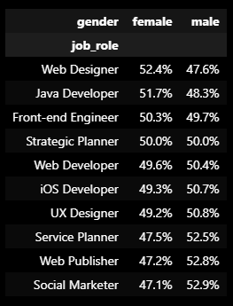
2nd level analysis
Next, I will take a deeper dive into the data.
I broken down the average application rate & hire rate of the users from the top 10 countries.
Even though users’ were mainly from South Korea, UK has the highest average application rate of ~70 per user, however its unfortunately that none of the country has even average of 1 for their average hired rate.
Next its encouraging to see that the ratio of female to male in the top few tech roles is roughly balanced out as its often reported that females are being underrepresented in this industry.

Slide 10
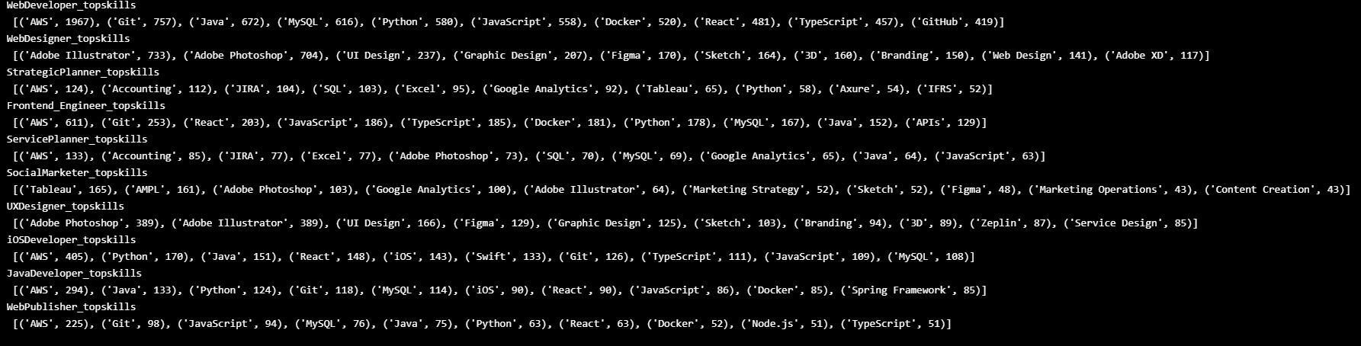
2nd level analysis
Lastly, I split up the user’s skills set of the top 10 roles to see what is the 10 most common skill that users in those roles have. It is represented by
(‘skill’, ‘number of users who have this skill’)
Immediately the top most common skill that majority of the users had are AWS (amazon web service), goes to show that AWS is a valuable skill to have to be in these roles.

Slide 11
Take away from the Data
From a business perspective, its positive sign to see the steady increase in sign up rate since 2015.
The average users using the platform are early in their careers (as shown from their year of experience), also signs that the average users base are quite young. Something the company can consider doing is organizing a “platform member only” career talks from veteran in the industry. This aim to reduce the inactive period of the users and attract more young talents onto the platform.
We could make use of the data on user’s skill to assist users themselves with job search. The company can consider building a skill match algorithm based on the jobs the user are interested in and the user’s skill to match them together. Or if the skills does not match, the algorithm will propose what skills the applicant is lacking so the applicant is aware and can work towards that area. This aims to improve user satisfactory level by increasing their chance of being hired through the platform.

